Slide 1
Implementing Windows Virtual Desktop in the enterprise
Trainer Name
Notes:
Information in this document, including URL and other Internet Web site references, is subject to change without notice. Unless otherwise noted, the example companies, organizations, products, domain names, e-mail addresses, logos, people, places, and events depicted herein are fictitious, and no association with any real company, organization, product, domain name, e-mail address, logo, person, place or event is intended or should be inferred. Complying with all applicable copyright laws is the responsibility of the user. Without limiting the rights under copyright, no part of this document may be reproduced, stored in or introduced into a retrieval system, or transmitted in any form or by any means (electronic, mechanical, photocopying, recording, or otherwise), or for any purpose, without the express written permission of Microsoft Corporation.
Microsoft may have patents, patent applications, trademarks, copyrights, or other intellectual property rights covering subject matter in this document. Except as expressly provided in any written license agreement from Microsoft, the furnishing of this document does not give you any license to these patents, trademarks, copyrights, or other intellectual property.
The names of manufacturers, products, or URLs are provided for informational purposes only and Microsoft makes no representations and warranties, either expressed, implied, or statutory, regarding these manufacturers or the use of the products with any Microsoft technologies. The inclusion of a manufacturer or product does not imply endorsement of Microsoft of the manufacturer or product. Links may be provided to third party sites. Such sites are not under the control of Microsoft and Microsoft is not responsible for the contents of any linked site or any link contained in a linked site, or any changes or updates to such sites. Microsoft is not responsible for webcasting or any other form of transmission received from any linked site. Microsoft is providing these links to you only as a convenience, and the inclusion of any link does not imply endorsement of Microsoft of the site or the products contained therein.
© 2017 Microsoft Corporation. All rights reserved.
Microsoft and the trademarks listed at https://www.microsoft.com/en-us/legal/intellectualproperty/Trademarks/Usage/General.aspx are trademarks of the Microsoft group of companies. All other trademarks are property of their respective owners.
August 2020

Slide 2
Implementing Windows Virtual Desktop in the enterprise
Whiteboard Design Session

Slide 3
Abstract and learning objectives
In the Whiteboard Design Session (WDS), you will work in groups to design a Windows Virtual Desktop solution using Microsoft 365 and Azure technologies.
Your solution will consider the necessary Microsoft 365 subscription required for Windows 10 multi-user licensing, as well as the Azure Active Directory and security needs for a healthcare provider. You will need to determine how to connect Azure to the current VMware and Citrix on-premises infrastructure and the connections needed to connect this infrastructure to Azure for application access. Finally, you will need to design the Windows Virtual Desktop solution utilizing Azure virtual machines with availability and scalability to handle 24x7x365 operations without performance degradation.
At the end of the whiteboard design session, you will be better able to design a solution that leverages Microsoft 365 and Azure technologies together to build a secure and robust Windows Virtual Desktop infrastructure.
Notes:
In the Whiteboard Design Session (WDS), you will work in groups to design a Windows Virtual Desktop solution using Microsoft 365 and Azure technologies.
Your solution will consider the necessary Microsoft 365 subscription required for Windows 10 multi-user licensing, as well as the Azure Active Directory and security needs for a healthcare provider. You will need to determine how to connect Azure to the current VMware and Citrix on-premises infrastructure and the connections needed to connect this infrastructure to Azure for application access. Finally, you will need to design the Windows Virtual Desktop solution utilizing Azure virtual machines with availability and scalability to handle 24x7 operations without performance degradation.
At the end of the whiteboard design session, you will be better able to design a solution that leverages Microsoft 365 and Azure technologies together to build a secure and robust Windows Virtual Desktop infrastructure.

Slide 4
Step 1: Review the customer case study
Outcome
Analyze your customer needs.
Timeframe
15 minutes

Slide 5
Customer situation
Contoso Healthcare
Healthcare provider
Annual revenues of USD $200 million
National company
Headquarters in Los Angeles, CA
Network of affiliate hospitals and doctor’s offices throughout North America. Growth through acquisition
250 workstations for non-clinical users are currently supported
Data centers located in California and Northern Virginia
Current virtual desktop infrastructure investment in VMware and Citrix
Notes:
Contoso Healthcare, headquartered in Los Angeles, California, is a national healthcare provider with a network of affiliate hospitals and doctor’s offices located throughout North America. These locations continue to grow through acquisition. The nature of their business requires a high level of security of personal identifiable information (PII) for their employees.
Contoso currently has approximately 250 workstations within their environment with business applications for non-clinical users from the Developer, Finance, and Knowledge departments. Contoso is currently supporting existing data centers in California and Northern Virginia with VMware for the server control plane and a partial deployment of Citrix virtual desktop infrastructure.
*** Move to California, CCPA (CA equiv of GDPR)

Slide 6
Customer situation
Ken Greenwald, Contoso Healthcare CTO
Understands the value of the cloud for availability and scalability
Focus on standardization of desktop images and manage published applications
Wants to avoid the need to manage desktops at individual locations
Interested in minimizing additional capital investments and maximizing current VMware and Citrix virtual desktop infrastructure in Azure
Laura Knight, Contoso Healthcare CISO
Wants to avoid data exposure of PHI and PII
Compliance to California Personal Protection Act
Focus on securing data and resources
Concerned with potential data loss due to device theft

Slide 7
Customer Needs—Security #1
Increased need for mobile devices for non-clinical users
Device theft could cause data exposure
Management of authorized applications and block unauthorized cloud applications
Manage and monitor application use and vulnerabilities within a single platform
Ability to log and audit activity to identify potential threats

Slide 8
Customer Needs—Security #2
Minimize data stored on local devices to mitigate PII exposure
Maintain compliance to California Personal Protection Act
Notes:
The business of healthcare has become more reliant on mobile devices to access patient health records, which has created a concern over theft and data exposure. Contoso would like to eliminate the possibility of any PII being located on a local device through use of a virtual desktop infrastructure.
Since Contoso Healthcare is headquartered in California, they are required to comply to the California Personal Protection Act, which is very similar to GDPR requirements.

Slide 9
Customer Needs—Availability and Scalability
24x7 access to applications
High availability with limited capital investment
Ability to scale resources as demand increases
Network connections should be resilient with low latency to applications
Notes:
Being a healthcare provider, Contoso has a requirement for applications to be accessible 24x7, so any infrastructure should be designed with high availability and scalability in mind.

Slide 10
Customer Needs—Deployment Acceleration
Eliminate the need to update and manage local devices
Utilize the current VMware and Citrix virtual desktop infrastructure for the control plane for application access and delivery
Create a standardized desktop image for users to access Microsoft 365 and legacy on-premises applications
Notes:
*** Legacy app

Slide 11
Customer objections #1
The CTO at Contoso does not want to invest in new workstations and mobile devices to support the standardized desktop image. This includes non-OS, Macs, Android, and thin clients. Can these devices support the new image?
The CISO at Contoso needs to be convinced that data will not be exposed. How would Microsoft support the data protection needs for CH?

Slide 12
Customer objections #2
Contoso must be able to log and audit all activity on the desktop image. How will this be handled within the cloud and on-premises environments?
Connections between the cloud and existing data centers must be secure and reliable to support their requirements. How will this be addressed and monitored?
Contoso has made a substantial capital investment in their current data centers that they do not want to decommission. So would like to leverage existing infrastructure where possible.

Slide 13
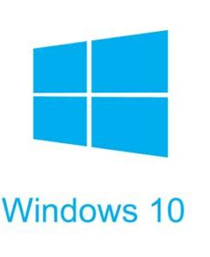
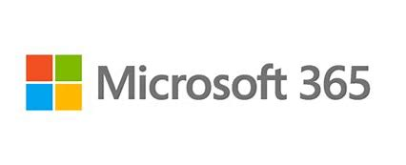
Common scenarios #1
Microsoft 365 subscription
Windows 10 multi-user license
Device management
Multi-factor authentication
Data protection
Identity protection
Conditional access

Slide 14
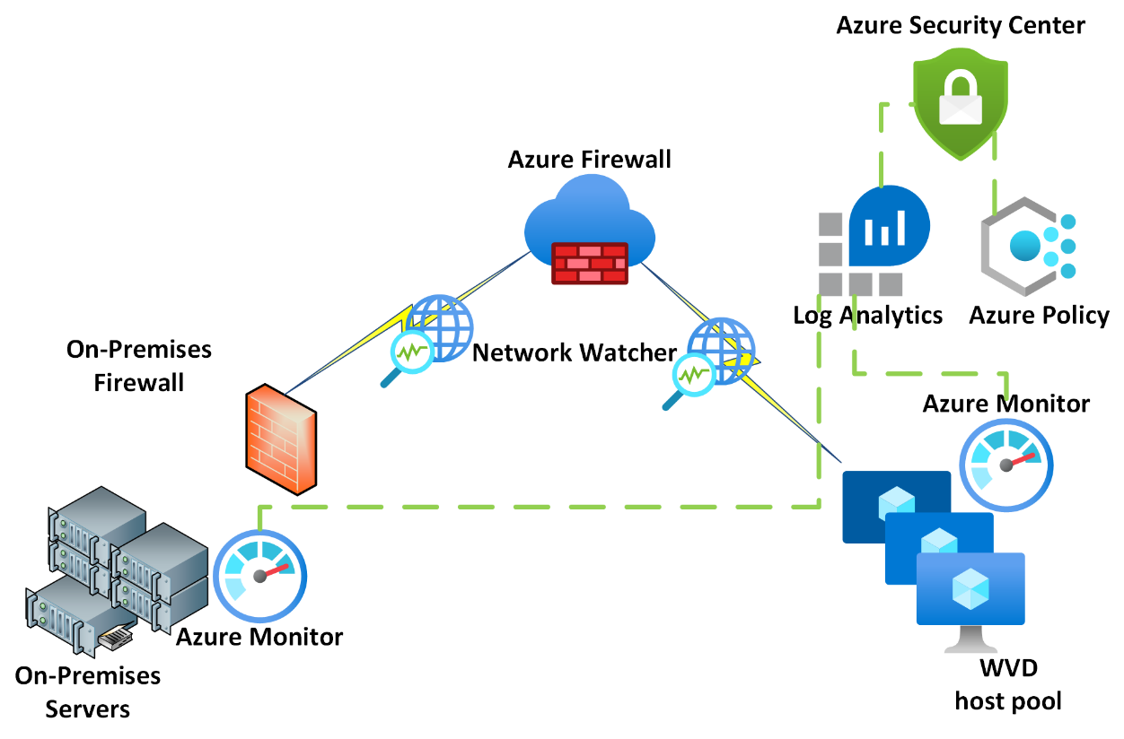
Common scenarios #2
Security
ISO 27001 and HIPAA controls
Monitoring and alerting
Data encryption
Identity and access management
Secure and Centralize file storage

Slide 15
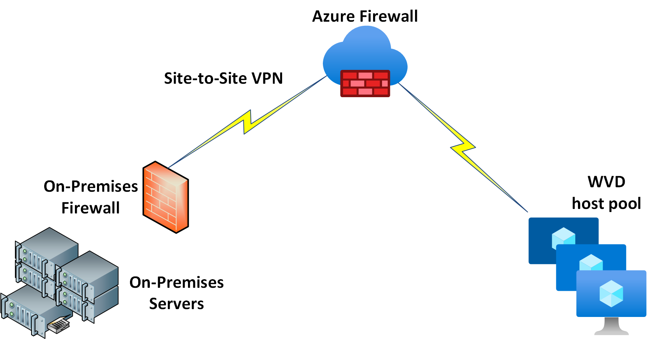
Common scenarios #3
Network connectivity
Create a virtual network for virtual machine pool
Connection to on-premises data center
Determine the User connection to desktop image
Remote Desktop Client
Web Client
Apple iOS or Android Remote Desktop app

Slide 16
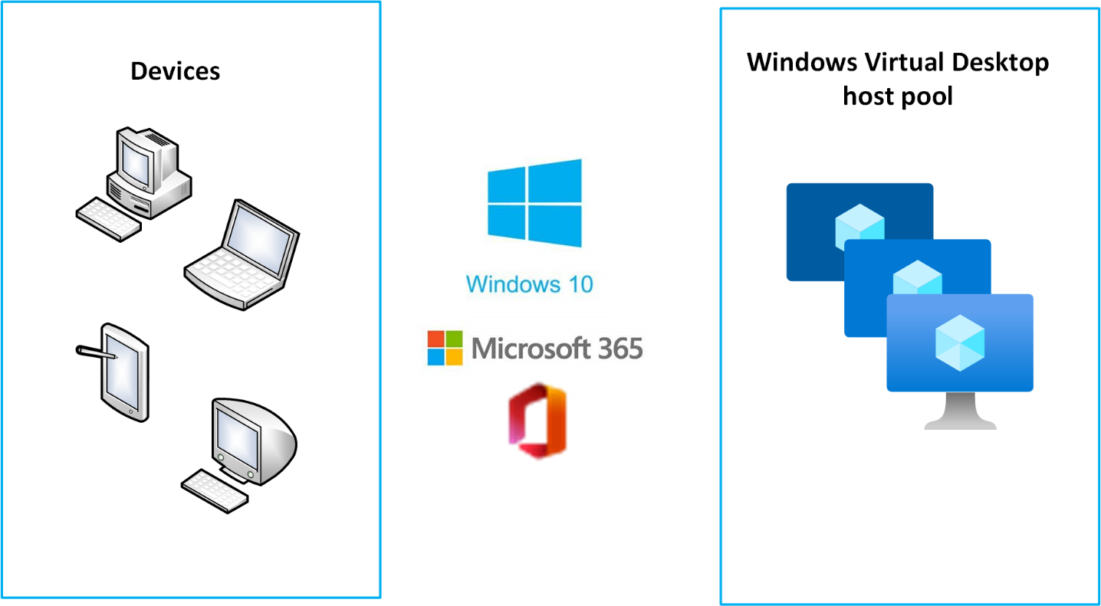
Common scenarios #4
Windows Desktop image
New Windows 10 Enterprise multi-user workspace
VHD image of existing workspace
Application delivery through the current VMware and Citrix environment

Slide 17
Common scenarios #5
Windows Virtual Desktop host pool
Define the number of con-current sessions
Create virtual machine availability set
Define desktop image

Slide 18
Step 2: Design the solution
Outcome
Design a solution and prepare to present the solution to the target customer audience in a 15-minute chalk-talk format.
Timeframe
60 minutes
Business needs (10 minutes) | Respond to questions outlined in your guide and list the answers on a digital Whiteboard.
Design (35 minutes) | Design a solution for as many of the stated requirements as time allows. Show the solution on a Whiteboard.
Prepare (15 minutes) | Identify any customer needs that are not addressed with the proposed solution. Identify the benefits of your solution. Determine how you will respond to the customer’s objections. Prepare for a 15-minute presentation to the customer.

Slide 19
Step 3: Present the solution
Outcome
Present a solution to the target customer in a 15-minute chalk-talk format.
Timeframe
30 minutes (15 minutes for each team to present and receive feedback)
Directions
Pair with another table.
One table is the Microsoft team and the other table is the customer.
The Microsoft team presents their proposed solution to the customer.
The customer asks one of the objections from the list of objections in the case study.
The Microsoft team responds to the objection.
The customer team gives feedback to the Microsoft team.

Slide 20
Wrap-up
Outcome
Identify the preferred solution for the case study.
Identify solutions designed by other teams.
Timeframe
15 minutes

Slide 21
Implementing Windows Virtual Desktop in the enterprise
Whiteboard Design Session – Preferred Solution

Slide 22
Preferred target audience
Ken Greenwald, CTO
Laura Knight, CISO
Desktop Administrators
Service Delivery Managers

Slide 23
Microsoft 365 Subscription requirements
Microsoft 365 E3/E5
Microsoft 365 A3/A5/Student Use Benefits
Microsoft 365 F3
Microsoft 365 Business Premium
Windows 10 Enterprise E3/E5
Windows 10 Education A3/A5
Windows 10 VDA per user
Ideal subscription for Contoso’s needs would be:
Microsoft 365 E5 with EMS E5
These subscriptions address the requirements for mobile device management, data classification and information protection, and conditional access policies.

Slide 24
Security requirements
ISO 27001 and HIPAA requirements
Azure Security Center Standard Tier and Azure Policy initiatives for HIPAA and ISO 27001 controls
California Personal Protection Act (similar to GDPR)
Monitoring and alerting
Azure Monitor agents installed on all Azure and on-premises virtual machines.
ATP should be used to monitor threats.
Azure Sentinel should be used for incident response and investigation
Data security and encryption
Cloud App Security for managing authorized applications.
All data in-transit will be sent across an encrypted SSL connection. Data at-rest will be encrypted in Azure file storage
Identity and access management
Azure Active Directory service with Azure AD Connect hash synchronization to on-premises Active Directory domain
Secure and Centralize file storage
Azure files will be used as the centralized file storage and share. File access will be controlled through Azure Active Directory roles
Notes:
Add, cloud app sec, sentinal , ATP

Slide 25
Network Connectivity
Regions and Resource Groups
West US and East US regions should be peered in Azure to decrease latency to California and Northern Virginia
Single resource group for the Window Virtual Desktop infrastructure
Virtual Network
Three peered VNETs: Virtual desktop host pool network, VPN to on-premises network, and Bastion host network
Load balancer will be used in front of the host pool virtual machines to decrease the public IP attack surface
Azure to on-premises network
Minimum requirement is Azure Firewall with Site-to-Site VPN
Ideal solution would be ExpressRoute to headquarters in CA and Northern VA.
Monitoring and alerting
Azure Monitor
Azure Log Analytics
Advance Threat Protection (ATP)
Network Watcher
Service Map
Azure Security Center
Azure Sentinel

Slide 26
Windows Desktop image
New Windows 10 multi-user workspace with Office 365 ProPlus
Application delivery through current Citrix app marketplace
Authorized applications managed through Cloud App Security
Managed image through WVD with creating a VHD image as an alternative option
User connection
Any of these are viable options
Remote Desktop Client
Web Client
Apple iOS or Android Remote Desktop app
Notes:
Use managed image, use VHD as alternate, app delivery through wvd,

Slide 27
Windows Virtual Desktop host pool
Define the number of con-current sessions –
250 users
Single host pool for Knowledge, Developer, and Finance users
Create virtual machine availability set –
25 DS4s v3 virtual machines
10 users per virtual machine
Notes:
Change to 250 users per 25 VMs
Call out workload scaling general guidelines/user personas
Published desktops (clinical) or published apps (non-clinical)?
Initial workload for non-clinical users (single host pool)

Slide 28
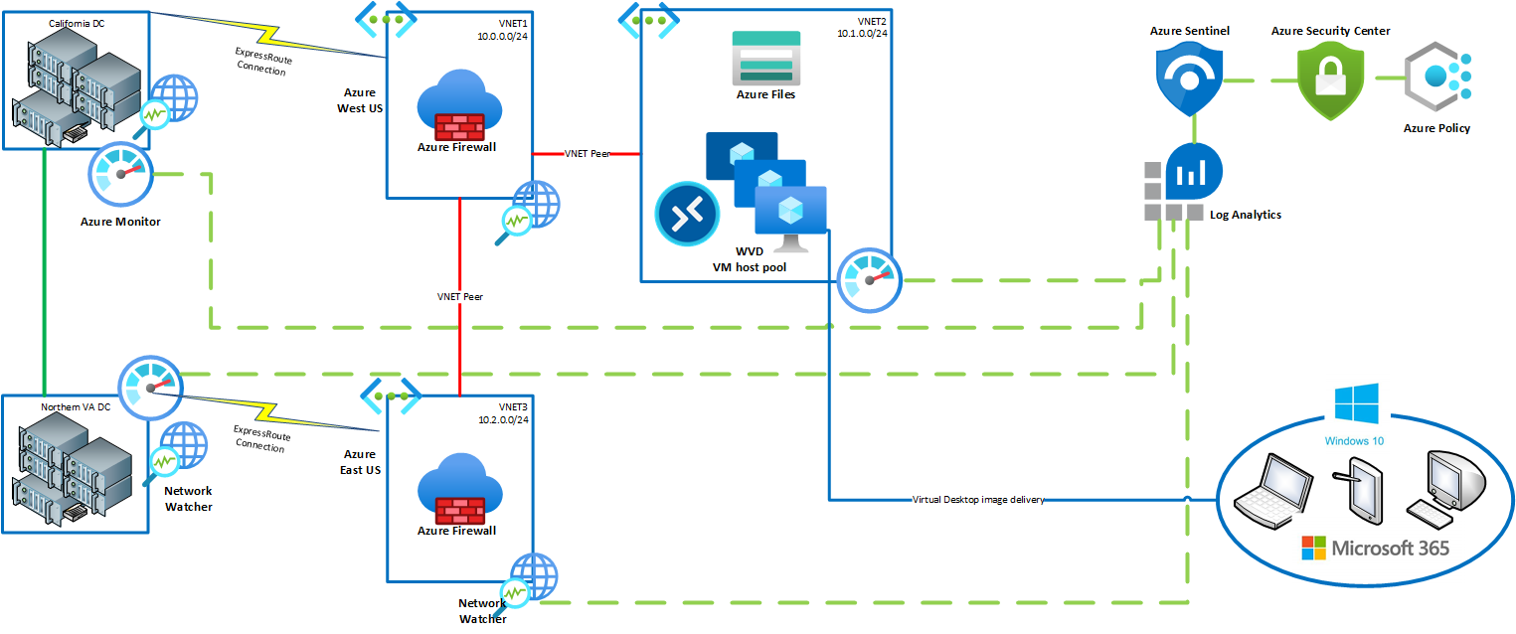
Solution Diagram
Notes:
Update based on new icons
Both sites should connect to Azure
More emphasis on peering
Need WVD control plane

Slide 29
Preferred objections handling #1
Objection
Contoso has made a substantial capital investment in their current data centers that they do not want to decommission. How can the infrastructure be architected to support the current data centers?
Potential answer
The designed solution has been architected to integrate the current application delivery configuration through Citrix into the standardized Windows Virtual Desktop image. In addition, Azure AD Connect will be used with hash synchronization to provide a single sign-on environment between the Azure Active Directory identity management and the existing on-premises Active Directory domain. As hardware is depreciated within the current data centers, application servers can be migrated to Azure and the Windows Virtual Desktop image can be updated for the new location of these servers.
Notes:
**Objection:**
**Answer:**
Focus more on WVD native solution, then talk about how Citrix & VMWare changes the solution. (note that Citrix & VMWare brings shorter time to solution)
Move this obj to the end
Segway to AMP

Slide 30
Preferred objections handling #2
Objection
The CTO at Contoso does not want to invest in new workstations and mobile devices to support the standardized desktop image. Can these devices support the new image?
Potential answer
Windows Virtual Desktop is flexible in the way that users can access their virtual desktop. The design will utilize web browser access to the virtual desktop on workstations, and the remote desktop app on mobile devices.
Notes:
**Objection:**
**Answer:**
Add non-windows OS scenario to this objection (macs and thin clients)

Slide 31
Preferred objections handling #3
Objection
The CISO at Contoso needs to be convinced that data will not be exposed. How would Microsoft handle data protection?
Potential answer
The designed solution for Contoso Healthcare includes Microsoft 365 E5 with Enterprise Mobility + Security (EMS) E5. This provides a full suite of data and information protection to classify sensitive data and audit activity. Cloud App Security can also be used to block access to unauthorized file sharing services to avoid users from copying files to unprotected locations. Data protection controls can be monitored through Microsoft 365 security adviser, and Azure Security Center.
Notes:
**Objection:**
**Answer:**
Note that Cloud App Security requires additional license
Callout Sentinal, Defender ATP, Security Center

Slide 32
Preferred objections handling #4
Objection
Contoso must be able to log and audit all activity on the desktop image. How will this be handled within the cloud and on-premises environments?
Potential answer
Azure Monitor and Azure Log Analytics will be activated within the Azure environment. Azure Monitor agents will be deployed to the on-premises virtual machines to monitor activity across the entire infrastructure.
Notes:
**Objection:**
**Answer:**

Slide 33
Preferred objections handling #5
Objection
Connections between the cloud and existing data centers must be secure and reliable to support their requirements. How will this be addressed and monitored?
Potential answer
The initial design will utilize a secure and encrypted site-to-site VPN connection from Azure to the Detroit data center. An option has also been provided to utilize an Azure ExpressRoute connection to provide private dedicated connectivity from Azure to the Detroit data center. Network Watcher will be used to monitor network traffic and throughput over the connections. Azure Security Center and Advanced Threat Protection will be in place to monitor and alert on potential vulnerabilities and threats.
Notes:
**Objection:**
**Answer:**
Sentinal

Slide 34
Customer Quote
"Azure has designed a secure and manageable infrastructure that can grow with Contoso Healthcare. This depth and breadth will allow us to meet both our business needs and regulatory requirements for our applications. Not to mention ensuring that our healthcare practitioners will have access to the patient data that they need when they need it.“
Ken Greenwald, CTO of Contoso Healthcare

